Slide 1

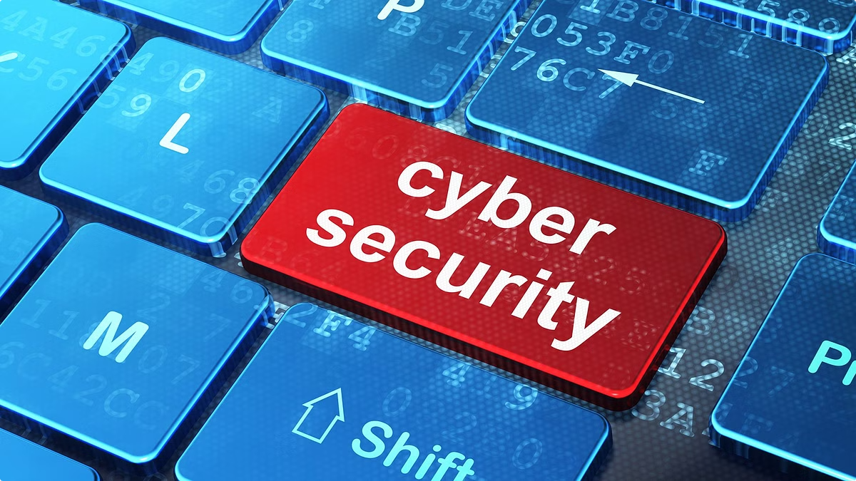

Phishing Attacks: Recognizing and Avoiding the Threat
Phishing attacks are a growing threat to individuals and businesses. These malicious tactics can compromise personal information, financial accounts, and sensitive data.
by Umar Aziz

Slide 2

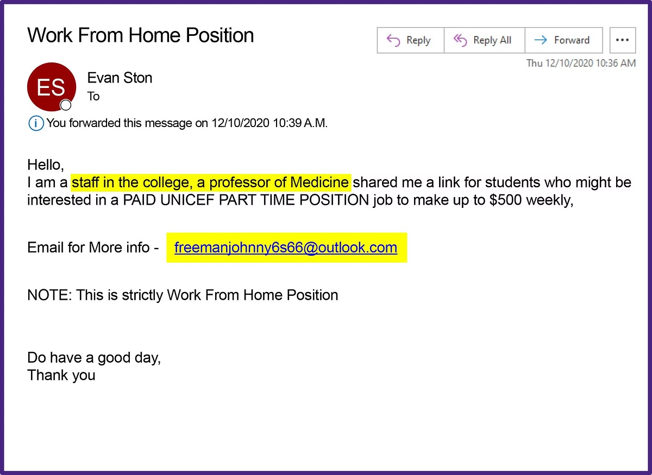
What is Phishing?
Phishing is a type of cybercrime where attackers use deceptive emails, texts, or websites to trick victims into revealing sensitive information.
1
Fraudulent
2
Deception
Attackers create fake emails, websites, or messages to mimic legitimate organizations.
They aim to trick victims into providing personal information, login credentials, or financial details.
3
Exploitation
Attackers can use stolen information for identity theft, financial fraud, or malware distribution.

Slide 3

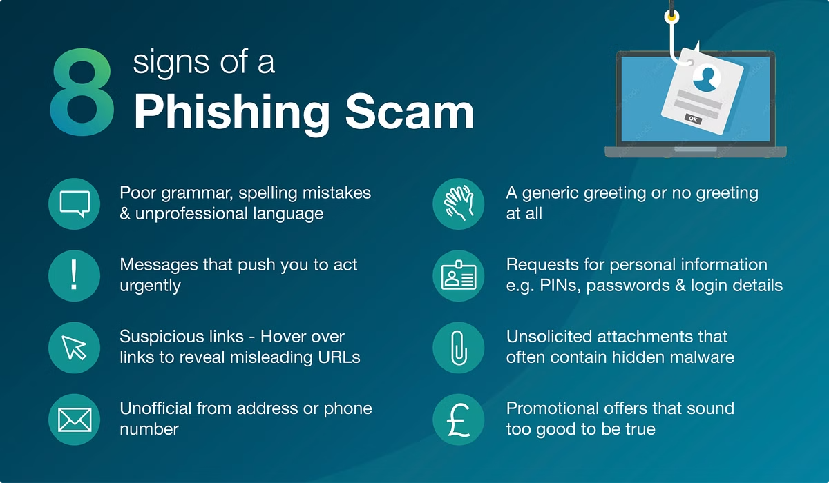
Common Phishing Tactics
Phishing attacks can take many forms, but some common tactics include spoofed emails, fake websites, and social engineering.
Spoofed Emails
Fake Websites
Attackers mimic legitimate organizations' emails to appear authentic.
They create websites that look identical to legitimate ones to steal credentials.
Social Engineering
Attackers use psychological manipulation to trick victims into revealing information.

Slide 4
Identifying Phishing Emails
While phishing emails can be sophisticated, there are telltale signs to look out for.
Suspicious Sender
Urgent Tone
Suspicious Links
Check the email address for misspellings or unusual domains.
Phishing emails often create a sense of urgency, pressuring victims to act quickly.
Hover over links before clicking to see the actual destination URL.

Slide 5





Spotting Malicious Websites
Be cautious when visiting websites, especially those you haven't visited before.
URL Check
Examine the URL for misspellings or unusual domains.
Security Indicators
Look for a padlock icon in the address bar and a valid SSL certificate.
Website Content
Inspect the website for grammatical errors, poor design, or suspicious content.

Slide 6

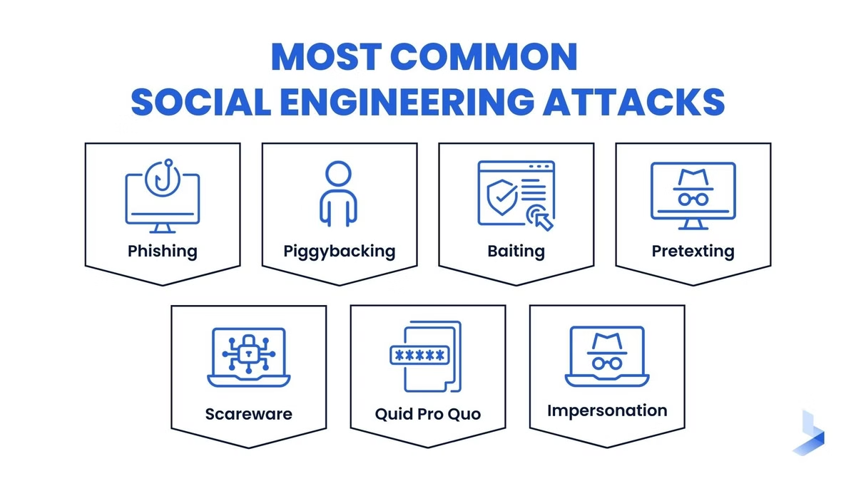
Dangers of Social Engineering
Social engineering involves manipulating people into revealing information or taking actions that benefit the attacker.
Impersonation
Attackers pretend to be someone they are not, such as a trusted colleague or authority figure.
Pretexting
They create a believable story or scenario to gain access to information.
Baiting
Attackers offer tempting incentives or rewards to trick victims into revealing information or clicking malicious links.

Slide 7


Protecting Yourself from Phishing
You can take steps to protect yourself from phishing attacks and secure your data.
1
Be Skeptical
Don't trust unsolicited emails or messages, especially those that ask for sensitive information.
2
Verify Information
If you receive an email that seems suspicious, verify the information with the sender directly.
3
Use Strong Passwords
Create unique and strong passwords for your online accounts.

Slide 8






Best Practices for Employees
Organizations should implement best practices to educate and protect employees from phishing attacks.
Regular Training
Security Policies
Reporting Mechanism
Awareness Campaigns
Provide employees with training on phishing detection and prevention.
Implement clear security policies and procedures for handling emails and online interactions.
Establish a system for employees to report suspected phishing attempts.
Promote cybersecurity awareness through newsletters, posters, and other communication channels.

Slide 9

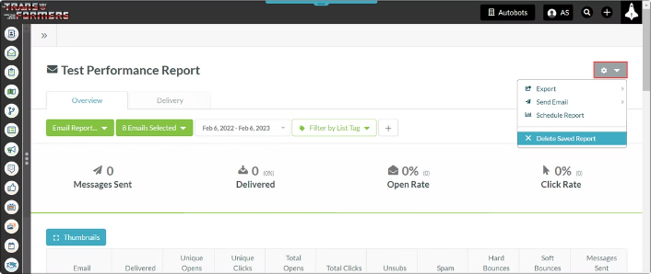
Reporting Suspected Phishing Attempts
If you receive a suspicious email, text, or encounter a malicious website, report it immediately.
1
Contact Your Organization
2
Report to Authorities
3
Forward the Email
Contact relevant authorities, such as the FBI or the FTC, to report phishing attacks.
If it's safe to do so, forward the suspicious email to the organization it claims to be from.
Report the phishing attempt to your IT department or security team.

Slide 10
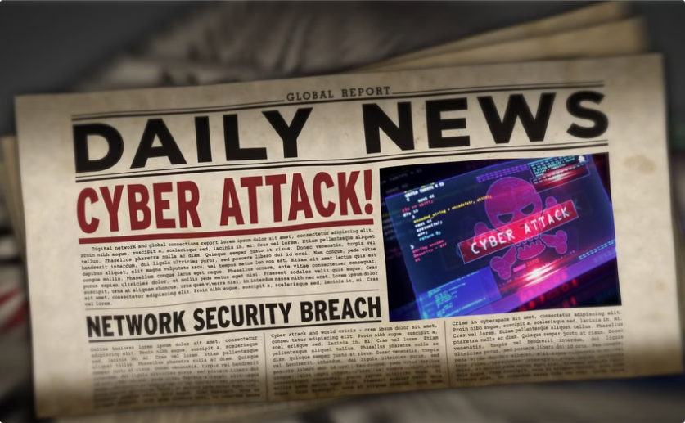
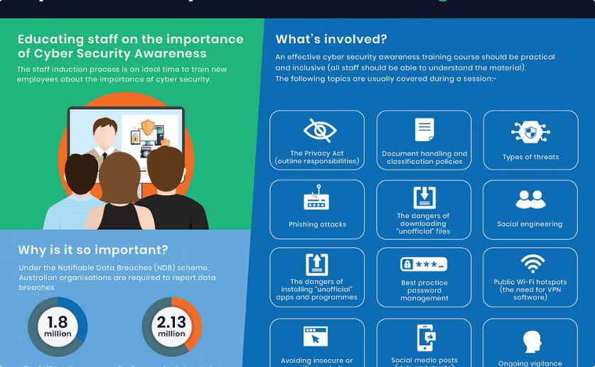
Staying Vigilant and Informed
Phishing attacks are constantly evolving, so it's crucial to stay vigilant and informed.
Read News and Updates
Seek Training
Keep up-to-date on current phishing trends and best practices.
Enroll in cybersecurity training courses to enhance your knowledge and skills.

